Slide 1
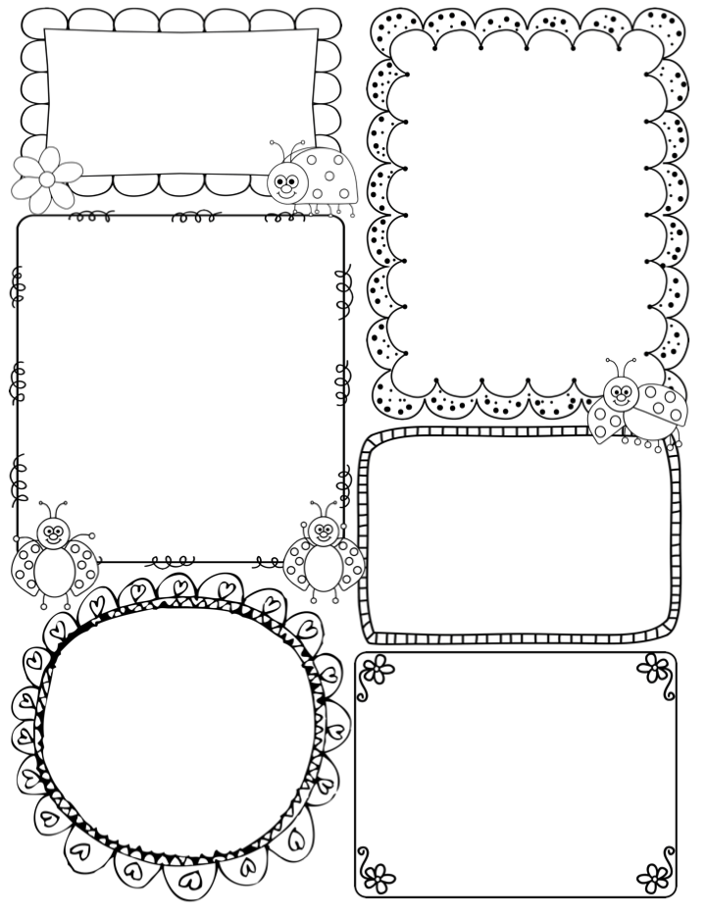
Mrs. Melby’s Class News
January 21-24 , 2020
Reminders
1/20 – No School - Martin Luther King Day
1/22 – Dessert Sale - $1
1/24 – Donut Sale - $1
1/27 – 100th Day of School Celebration (there will be a sign up genius sent home for items needed)
1/31– Pizza Day
Homework
Math: Lessons 6-1, 6-2, 6-3, 6-4
Language Arts: Phonics Pages and Reading Comprehension pages
Your child can always go on Raz-Kids or Istation to practice as well
Phonics for the week
Sight words: and, are, come, for
Word Family: Short a word family
Character Trait:
Self-Motivation
Working in a careful and consistent manner without giving up!
Star of the Week:
Kylie
Math: Topic 6 – Understanding Addition
Science: Weather
Social Studies: Respect
Story: Ice Bear by Nicola Davies
Health: Establishing a trusted triangle

